Slide 1

Requirement Analysis Overview
This presentation covers a detailed analysis of the project requirements, highlighting completeness, clarity, technical feasibility, and dependencies. We also address inconsistencies, ambiguities, and missing information found during the review.It also clarify the app's purpose, scope, intended users, and key functional and non-functional requirements. Finally, we present a prioritization of requirements to guide development focus.
The goal is to ensure a clear understanding of user and system needs, identify gaps, and set priorities for successful implementation.

Slide 2

Review and Analysis of Requirements
Completeness
Requirements cover most user and system needs like real-time monitoring, feedback collection, privacy controls, alerts, and multilingual support. Backend analytics and admin panel needs require further specification.
Clarity
Functional requirements are fairly clear, but some non-functional goals such as "high reliability" need precise metrics like 99.9% uptime.
Technical Feasibility
The project is feasible using current mobile technologies (Android/iOS SDKs, backend servers, analytics). Privacy implementation must comply with legal standards.
Dependency Relationships
Features depend on others; for example, privacy settings must precede geolocation feedback, and notifications rely on real-time monitoring availability.

Slide 3

Inconsistencies, Ambiguities, and Missing Information
Ambiguity
"Minimal CPU and battery usage" is subjective; clearer limits like 2% battery per hour are needed.
Missing Information
No detailed backend requirements for data storage and processing were provided.
Inconsistency
MTN’s reluctance to share data conflicts with app feedback suggesting external reporting without clear integration strategy.
Dependency Concern
Offline caching requires a defined synchronization strategy for when connectivity is restored, which is currently unclear.

Slide 4
Prioritization and Summary
High Priority
Medium & Low Priority
Real-time network speed monitoring
Service history logs, multilingual interface (English/French), offline data caching
Privacy and data control settings
Network quality alerts
Third-party system integration, loyalty systems, community dashboard, regional benchmarking
User feedback submission
Low battery consumption and security measures
The requirements are generally complete and feasible, with some areas needing more detail. Ambiguities around resource usage, offline sync, and data privacy were identified. Prioritization guides development focus to maximize user satisfaction and technical success.

Slide 5
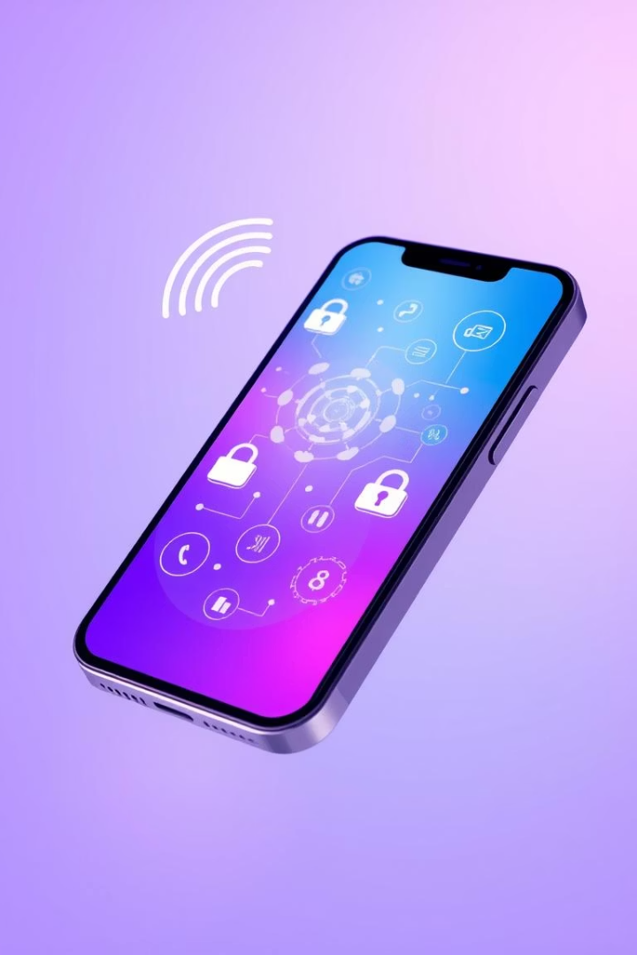
Purpose and Scope
Purpose
Define functional and non-functional requirements for a mobile app monitoring network QoE in Cameroon.
Scope
Collect real-time network metrics, allow manual issue reporting, notify users of problems, support privacy controls, and offer English and French interfaces.

Slide 6
Intended Audience and Key Definitions
Audience
Definitions
Mobile Subscribers (End Users)
QoE: Quality of Experience
Mobile Network Operators (MTN, Orange)
CPU: Central Processing Unit
App Development Team
GDPR: General Data Protection Regulation
Regulatory Authorities (ART Cameroon)

Slide 7
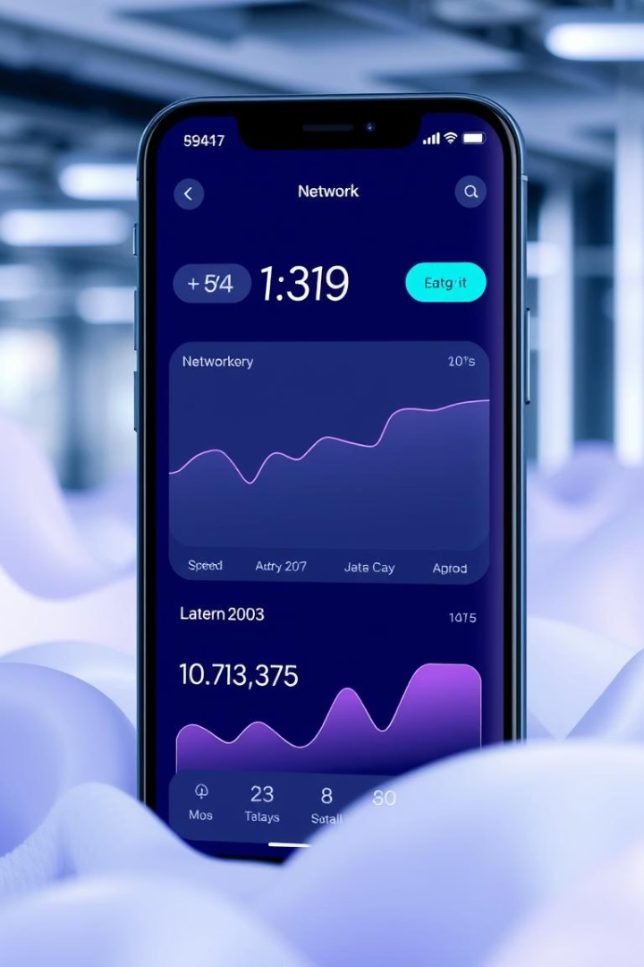
Product Perspective & Functions
Product Perspective
Operates independently on Android and iOS; optionally links to operator support systems like MTN Zigi.
Product Functions
Real-time network speed, latency, stability measurement
Background monitoring with low battery impact
Manual feedback with geolocation tagging
Notification alerts for disruptions
Privacy dashboard and multilingual UI

Slide 8
User Classes, Constraints, and Dependencies
User Classes
Constraints & Dependencies
End Users: Students, workers, urban and rural residents
Compliance with data privacy laws
Network Operators: Technical staff, support managers
High performance on low-end devices
Opt-in, transparent data collection
Regulators: Analysts overseeing service standards
Mobile data/Wi-Fi availability
Access to mobile OS APIs

Slide 9
Functional Requirements Overview
1
FR-1: Real-time Speed Monitoring
Display upload and download internet speed continuously.
2
FR-2: Manual Feedback
Allow users to submit reports on network issues with geolocation.
3
FR-3: Notifications
Alert users when network drops or disruptions occur.
4
FR-4: Privacy Settings
Enable users to configure data sharing preferences.
5
FR-5: Service History
Show service history, optionally link to operator tools, support English and French.
6
FR-4: Link to Operator support
The system shall link users to existing operator support tools (optional).
7
FR-4: Language Option
The system shall support both English and French languages.

Slide 10
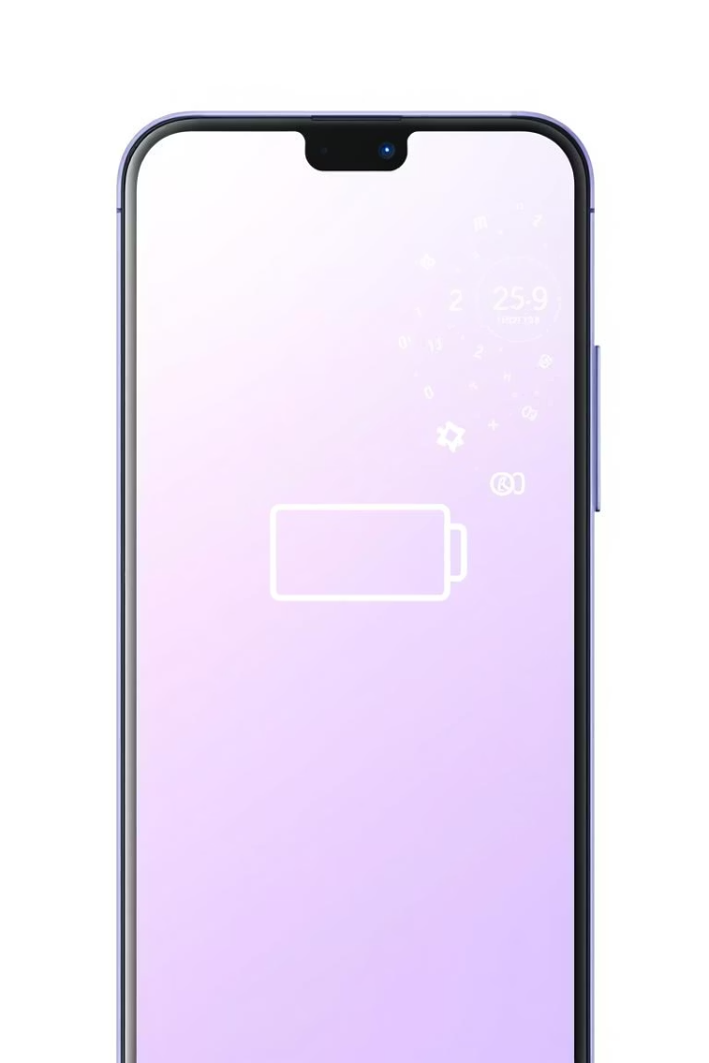
Non-Functional Requirements
Battery Efficiency
Consume less than 3% battery per hour during monitoring.
Data Security
Encrypt user data during transmission to ensure privacy.
Reliability & Compatibility
Support 99.9% uptime and run on Android 8+ and iOS 12+ devices.
User Interface
Provide an intuitive and minimalistic UI for ease of use.

Slide 11





Validation Process with Stakeholders
Step 1: Present SRS
Share the document with students, network operators, and regulators.
Step 2: Collect Feedback
Conduct meetings and online surveys to gather input.
Step 3: Acceptance Criteria
Ensure requirements are necessary, clear, achievable, and testable.
Step 4 & 5: Update & Sign-off
Revise SRS based on feedback and obtain formal approval from key stakeholders.

Slide 12

Key Assumptions and Dependencies
Network Access
User Participation
Users must have mobile data or Wi-Fi to transmit data.
Users are willing to share anonymous feedback voluntarily.
Technical Access
App requires access to mobile OS APIs for accurate network measurements.

Slide 13
Conclusion
This presentation gives an insight on the purpose, scope, intended users, and key functional and non-functional requirements of a mobile app designed to monitor mobile network Quality of Experience (QoE) for subscribers in Cameroon. .
THANKS

